Slide 1
The Tragedie of Macbeth by William Shakespeare
Madhumita Biswas
Assistant Professor
Department of English
Session 2019-2020
Semester - 1st Semester, CC1
Khatra Adibasi Mahavidyalaya

Slide 2

Macbeth:
Macbeth is a play written by William Shakespeare, likely first performed in 1606.
The play is set in medieval Scotland and follows the rise and fall of the title character, Macbeth, a Scottish nobleman.

Slide 3
Key Features of the play:
Macbeth is often considered a commentary on the nature of power and how it can corrupt even the most honorable of men.
Philosophically, the play explores the concept of fate versus free will, as the witches' predictions seem to drive Macbeth's actions, but ultimately he is the one who chooses to act on them.
The play also deals with the theme of appearance versus reality, as Macbeth's actions are driven by his ambition, but he attempts to justify them through noble-sounding rhetoric.

Slide 4
Character List:
Macbeth
Lady Macbeth
The Three Witches
Banquo
Macduff

Slide 5
Main themes:
The Corrupting Power Of Unchecked Ambition.
The Relationship Between Cruelty And Masculinity.
The Difference Between Kingship And Tyranny.

Slide 6
Key features:
Macbeth has been interpreted as a political allegory, with Macbeth representing the dangers of tyranny and the need for a strong, just leader.
The play also deals with the themes of masculinity and femininity, as Lady Macbeth's ambition and manipulation of her husband is seen as a subversion of traditional gender roles.
Macbeth is considered an example of the "Tragic Hero" archetype, as the character starts off as a noble and honorable person, but is ultimately brought down by his own flaws and weaknesses.
The play is also linked to the historical context of Shakespeare's England, as it was written during the reign of King James I, who had recently ascended to the throne through a violent power struggle.

Slide 7
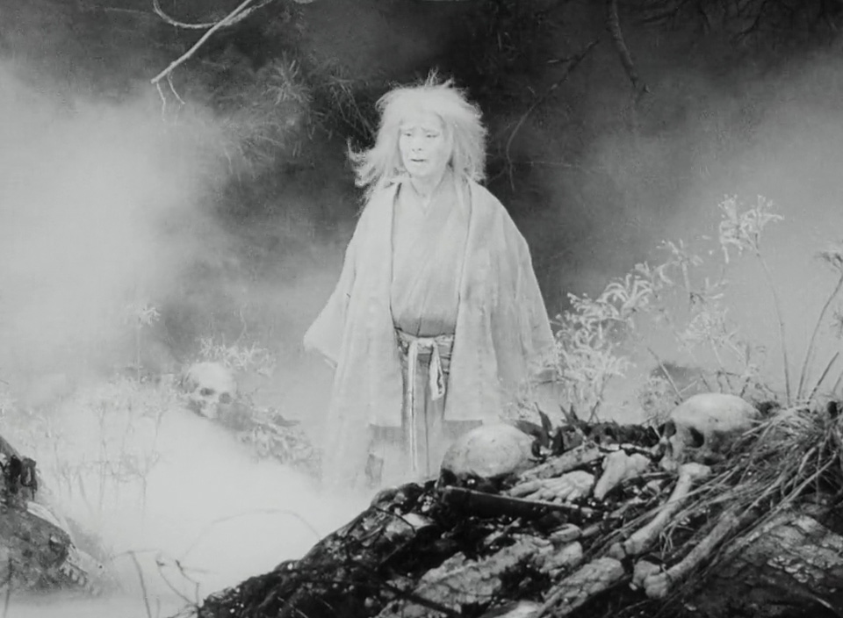
Themes:
Macbeth also explores the theme of supernatural, it can be seen as a representation of the fear of the unknown, and the desire for control over it.

Slide 8
In-depth observations:
The play is also linked to the historical context of medieval Scotland, as it deals with the power struggles and political turmoil of the time.
Philosophically, Macbeth can be seen as an exploration of the human condition and the darker aspects of human nature, such as ambition, greed, and guilt.

Slide 9
Important quotes:
“Fair is foul, and foul is fair, hover through fog and filthy air.”
Macbeth Act 1, Scene 1
Lady Macbeth:
The raven himself is hoarse
That croaks the fatal entrance of Duncan
Under my battlements. Come, you spirits
That tend on mortal thoughts, unsex me here,
And fill me from the crown to the toe topful
Of direst cruelty!
Macbeth Act 1, scene 5, 38–43

Slide 10
Thank you!

